Slide 1
My Shape and Angles
Interactive Notebook
Name
Class
Term 3 Semester 2

Slide 2
Contents
Formula Page
Page
Date
Description
2
3

Slide 3
Tasks
24
7
30
Essential Question
Questions
Notes
Summary
14
15

Slide 4
24
7
30
Date
Polygons
Describe how to find the sum of the interior angle for any polygon?
15

Slide 5
24
7
30
Date
Polygons
Describe how to find the sum of the interior angle for any polygon?
A polygon is the name of shape with straight sides.
A regular Polygon has all the sides the same length and the angles the same size
15

Slide 6
24
7
30
Date
Polygons
Describe how to find the sum of the interior angle for any polygon?
A polygon is the name of shape with straight sides.
Regular Hexagon
Regular Pentagon
Irregular
hexagon
Irregular
Pentagon
A regular Polygon has all the sides the same length and the angles the same size
15

Slide 7
Copy and complete the table
Polygon Name | Number of Sides | Number of Triangles | Angle Sum
 | 3
 | 4
 | 5
 | 6
 | 7
 | 8
 | 9
 | 10
N-sided polygon | n

Slide 8
Copy and complete the table
Polygon Name | Number of Sides | Number of Triangles | Angle Sum
Triangle | 3
Quadrilateral | 4
Pentagon | 5
Hexagon | 6
Heptagon | 7
Octagon | 8
Nonagon | 9
Decagon | 10
N-sided polygon | n | n - 2

Slide 9
Copy and complete the table
Polygon Name | Number of Sides | Number of Triangles | Angle Sum
Triangle | 3 | 1
Quadrilateral | 4 | 2
Pentagon | 5 | 3
Hexagon | 6 | 4
Heptagon | 7 | 5
Octagon | 8 | 6
Nonagon | 9 | 7
Decagon | 10 | 8
N-sided polygon | n | n - 2

Slide 10
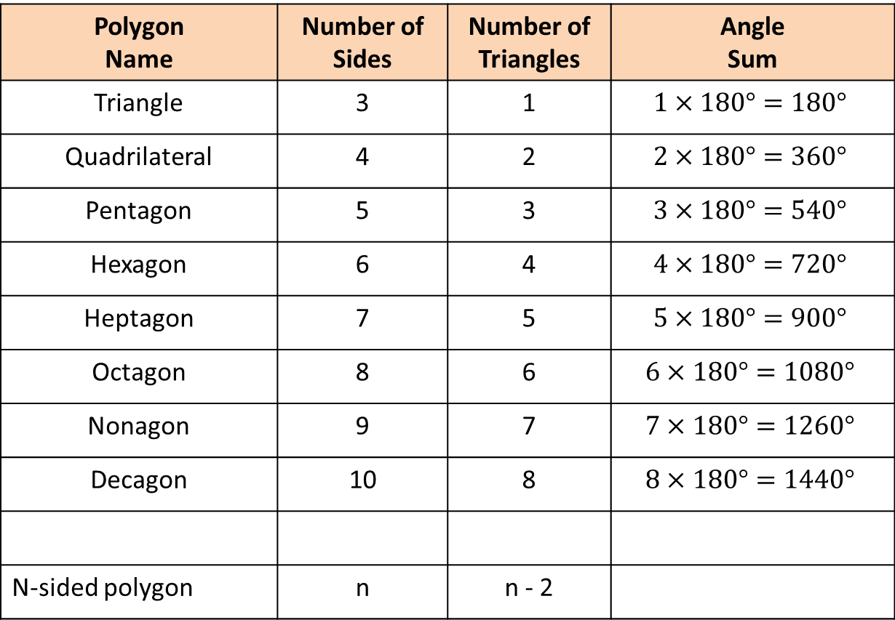
Copy and complete the table
Polygon Name | Number of Sides | Number of Triangles | Angle Sum
Triangle | 3 | 1 | $$1×180°=180°$$
Quadrilateral | 4 | 2 | $$2×180°=360°$$
Pentagon | 5 | 3 | $$3×180°=540°$$
Hexagon | 6 | 4 | $$4×180°=720°$$
Heptagon | 7 | 5 | $$5×180°=900°$$
Octagon | 8 | 6 | $$6×180°=1080°$$
Nonagon | 9 | 7 | $$7×180°=1260°$$
Decagon | 10 | 8 | $$8×180°=1440°$$
N-sided polygon | n | n - 2

Slide 11

Copy and complete the table
Polygon Name | Number of Sides | Number of Triangles | Angle Sum
Triangle | 3 | 1 | $$1×180°=180°$$
Quadrilateral | 4 | 2 | $$2×180°=360°$$
Pentagon | 5 | 3 | $$3×180°=540°$$
Hexagon | 6 | 4 | $$4×180°=720°$$
Heptagon | 7 | 5 | $$5×180°=900°$$
Octagon | 8 | 6 | $$6×180°=1080°$$
Nonagon | 9 | 7 | $$7×180°=1260°$$
Decagon | 10 | 8 | $$8×180°=1440°$$
n-sided polygon | n | n - 2 | (n – 2) $×180$

Slide 12

24
7
30
Date
Polygons
Describe how to find the sum of the interior angle for any polygon?
A polygon is the name of shape with straight sides.
Regular Hexagon
Regular Pentagon
Irregular
hexagon
Irregular
Pentagon
A regular Polygon has all the sides the same length and the angles the same size
The angles in a n-sided polygon sum to
$$(n−2)×180$$
15

Slide 13
Questions

Slide 14
Notes Review
24, 7 ,30
Date
Title
Essential question
Notes complete
Notes complete with colour and diagrams
Questions completed
Contents page filed in
Formula page filled in

Slide 15
Homework
Review your notes and write a summary answering the essential question.

